Slide 1
05
MACHINE LEARNING WITH SCIKIT-LEARN
Regression Models
Open the first black boxes: linear models with regularization, trees, and neighbors — predicting numbers honestly.
Instructor: Shutchon Premchaisawatt
Master's Degree Program · Hands-on with Google Colab

Slide 2
AGENDA
Today's agenda
01
Linear regression, intuitively
the best straight line
05
Trees & neighbors for regression
non-linear patterns
02
Reading coefficients
what the model believes
06
Comparing all of them
baseline → winner
03
California housing
our benchmark today
07
Pitfalls
extrapolation, outliers, log targets
04
Regularization
Ridge & Lasso — keeping weights sane
Machine Learning with scikit-learn
SESSION 05 · 3

Slide 3
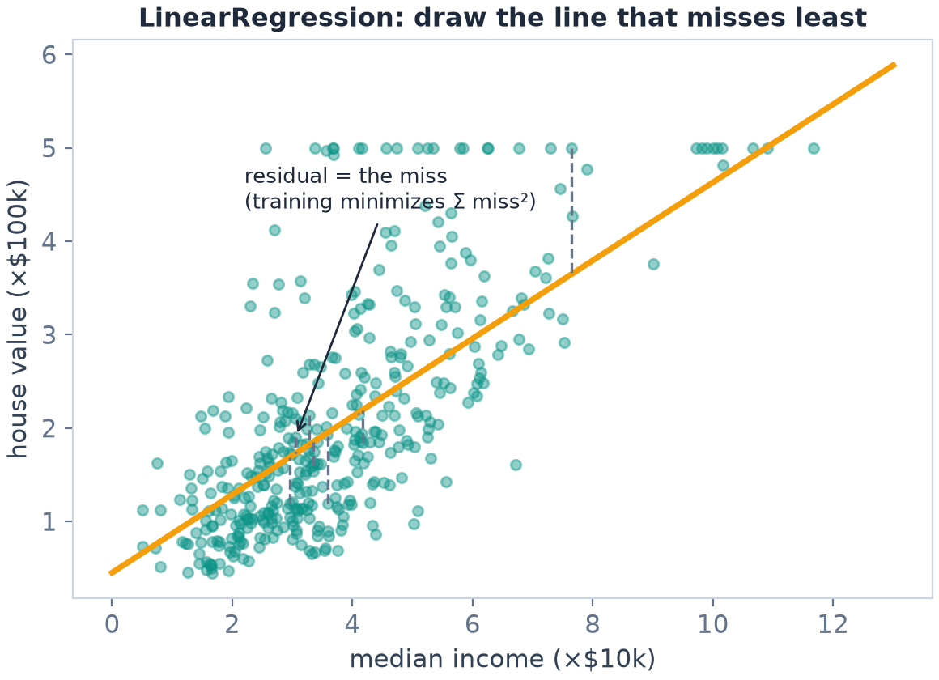
BLACK BOX #1
Linear regression: draw the best line
One sentence
choose the line (or plane) that makes the squared misses smallest
Loss = MSE = mean( (y − ŷ)² )
no hyperparameters — trains in milliseconds
the coefficient story is readable (next slide)
In sklearn: LinearRegression().fit(X, y) — that's it
Machine Learning with scikit-learn
SESSION 05 · 4

Slide 4
MATH YOU NEED
The whole model in one line
ŷ = w₁·MedInc + w₂·HouseAge + … + w₈·Longitude + b
w (weights / coefficients)
how much the prediction moves when a feature +1
the model's "beliefs" about each column
b (intercept)
prediction when every feature is 0
with scaled features: ≈ the average house value
training
pick w, b minimizing MSE
(closed-form or gradient descent — sklearn handles it)
No curve-fitting ritual, no epochs to babysit. One fit() call.
Machine Learning with scikit-learn
SESSION 05 · 5

Slide 5
BENCHMARK
California housing — 20,640 block groups
column | meaning | range
MedInc | median income (×10k) | 0.5 – 15
HouseAge | median house age | 1 – 52
AveRooms, AveOccup… | rooms / occupancy per house | …
Latitude, Longitude | where in California | map coords
y: house value | median price (×100k USD) | 0.15 – 5.0
Protocol (from S04)
split once: 80/20, random_state 42
evaluate on the test set only
baseline first — then models
  everything scaled inside a Pipeline
Task: predict a block's median house value from its census features — classic tabular regression.
from sklearn.datasets import fetch_california_housing
X, y = fetch_california_housing(return_X_y=True)
Machine Learning with scikit-learn
SESSION 05 · 6

Slide 6
INTERPRETATION
Reading the model's mind (scaled features)
feature (standardized) | weight | reads as
MedInc | +0.85 | richer block → pricier
AveOccup | −0.04 | crowded block → cheaper (slightly)
AveRooms | −0.29 | holds other features fixed (!)
Latitude | −0.90 | north → cheaper
Longitude | −0.87 | east → cheaper
intercept b | +2.07 | ≈ the average value ($207k)
Why coordinates dominate
California prices are a geography story (coast!) — linear models combine lat/lon into a tilted plane
Careful:
weights are PER-STD of the feature
correlation ≠ causation — description, not policy
AveRooms negative once income is fixed: big rooms in poor inland blocks
Machine Learning with scikit-learn
SESSION 05 · 7

Slide 7
RESULTS
Round 1 — baseline vs linear
model (test set) | MAE | R²
DummyRegressor(median) | 0.874 | −0.05
LinearRegression | 0.533 | 0.576
Habit
Every regression table in this course starts with the Dummy row.
If your fancy model doesn't clearly beat it, the fancy part is decoration.
In plain words:
average miss shrank from $87k to $53k
"predict the median" scores R² < 0
worse than predicting the mean — the definition of a floor
R² 0.576 from 8 straight lines — strong start
Why negative R²?
R² compares you to the mean-predictor. Scoring below the mean → below zero. It's a floor, not a bug.
Machine Learning with scikit-learn
SESSION 05 · 8

Slide 8
LIMITS
When a straight line isn't enough
Real prices bend:
income helps a lot until it saturates
distance-to-coast is not linear
Diagnosis tool: plot residuals (y − ŷ) vs ŷ
a pattern in residuals = the line missed structure
Three fixes ahead:
polynomial features · trees · neighbors
one straight line can't follow a bend — it averages the curve away
Machine Learning with scikit-learn
SESSION 05 · 9

Slide 9
FIX #1
Polynomial features: bend the plane with linear tools
from sklearn.preprocessing import PolynomialFeatures
poly = PolynomialFeatures(degree=2, include_bias=False)
X_poly = poly.fit_transform(X)
print(X.shape, "->", X_poly.shape) # (20640, 8) -> (20640, 44)
pipe = Pipeline([("poly", PolynomialFeatures(degree=2)),
("sc", StandardScaler()),
("m", LinearRegression())])
Idea
invent x², x₁·x₂ … then fit LINEARLY on them
MedInc² captures saturation · Lat×Lon lets the plane curve
Still a linear model — in the NEW features
Danger
degree 3 on 8 features → 165 columns; degree 5 → 1287
feature count explodes → overfitting → enter regularization (next)
Machine Learning with scikit-learn
SESSION 05 · 10

Slide 10
FIX #1'S BODYGUARD
Ridge & Lasso: penalize wild weights
Ridge (L2) — shrink everything a bit
Loss = MSE + α·Σw²
Big α → all weights pulled toward 0 → smoother model.
Keeps ALL features, humbles each one.
Ridge(alpha=1.0)
Lasso (L1) — cut features to zero
Loss = MSE + α·Σ|w|
Big α → some weights become exactly 0 → built-in feature selection.
Lasso(alpha=0.1) on housing: test R² 0.48 — punished TOO hard. α is a hyperparameter (S07 tunes it).
On California (8 clean features): Ridge ≈ Linear (R² 0.576) — nothing to fix
Regularization EARNS its keep with MANY / collinear / polynomial features
α = the dial between underfit (huge α) and overfit (α→0)
Machine Learning with scikit-learn
SESSION 05 · 11

Slide 11
FIX #2
Decision tree regression: ask, then average
"MedInc < 3.2? → room A : room B" … then predict the room's average price
Same tree machinery as classification (full tour in S06)
California results:
unrestricted: train R² 1.000 (!) · test 0.623
max_depth=8: test 0.678, MAE 0.448
the S04 overfitting curve, live on housing data
prediction = average value in each region (steps, not slopes)
Machine Learning with scikit-learn
SESSION 05 · 12

Slide 12
FIX #3
KNN regression: you cost what your neighbors cost
KNeighborsRegressor(n_neighbors=10)
# prediction = average value of the 10 most similar block groups
So which is "best"?
Same R² (0.678), different stories:
KNN — "similar places cost similar"
Tree — readable if-then rules
Both beat Linear, but Linear gives the cleanest EXPLANATION.
Prediction ≠ explanation — decide which one your stakeholder needs.
model | MAE | R²
LinearRegression | 0.533 | 0.576
DecisionTree(depth 8) | 0.448 | 0.678
KNN (k=10) | 0.440 | 0.678
Neighbors VOTE (classification) or AVERAGE (regression) — same trick as S01
Local memory beats the straight line (0.576 → 0.678) · needs scaling (S03!)
Machine Learning with scikit-learn
SESSION 05 · 13

Slide 13
SCOREBOARD
Everything we ran today (test set)
model | MAE | R² | note
Dummy(median) | 0.874 | −0.05 | floor
LinearRegression | 0.533 | 0.576 | readable weights
Ridge(α=1) | 0.533 | 0.576 | = linear here: few clean features
Lasso(α=0.1) | 0.622 | 0.481 | α too harsh — tune it (S07)
Tree (unrestricted) | 0.453 | 0.624 | train R² 1.000 — memorized
Tree (depth 8) | 0.448 | 0.678 | restricted = better
KNN (k=10) | 0.440 | 0.678 | needs scaling
MAE in $100k units: 0.44 ≈ "average miss of $44,000" — always translate metrics into money/sentence.
Machine Learning with scikit-learn
SESSION 05 · 14

Slide 14
GUIDE
Which regressor when?
situation | start with | strength | watch out
Need explanation / report | LinearRegression | weights = story | only linear patterns
Many/collinear/poly features | Ridge | tames weights | pick α (S07)
Want feature selection | Lasso | zeroes weights | α sensitive
Non-linear, tabular | Tree (depth-limited) | steps & rules | memorizes if free
Local similarity matters | KNN Regressor | no training at all | scale + slow deploy
“Need the best tabular accuracy”? That's ensembles — Session 06.
Machine Learning with scikit-learn
SESSION 05 · 15

Slide 15
PITFALLS
Four ways regression fools you
Extrapolation
Trained on incomes up to $150k — asked about $500k.
Linear happily predicts outside reality. Trees can't even (they clamp).
Know the data's borders.
Outliers & RMSE
One $5M mansion drags squared error.
RMSE punishes it; MAE shrugs.
Choose which behavior you WANT (S04).
Log targets
Prices span 0.15–5.0 × $100k — skewed.
np.log1p(y) at train, np.expm1 at predict → relative errors, saner model.
R² worship
R² 0.99 on train, 0.62 on test = decoration.
And R² compares to the mean-baseline only —
always pair with MAE in units.
Machine Learning with scikit-learn
SESSION 05 · 16

Slide 16
LAB 05 · DO IT IN GOOGLE COLAB
ทำนายราคาบ้านแคลิฟอร์เนีย — Regression showdown
YOUR MISSION (โจทย์ภาษาไทยใน Colab)
Learning goal
Run the full model zoo on California housing with the S04 protocol: baseline, pipeline, honest comparison, human-readable takeaway.
โหลด California housing แล้วแบ่ง 80/20 (random_state=42) — ใส่ทุกโมเดลใน Pipeline ที่มี StandardScaler
เริ่มด้วย DummyRegressor แล้ว LinearRegression — รายงาน MAE และ R²
ตีความสัมประสิทธิ์ของ LinearRegression: ฟีเจอร์ไหนผลักดันราคาขึ้น/ลงมากที่สุด?
เทียบ DecisionTree (ไม่จำกัด vs max_depth=8) — ช่องว่าง train/test บอกอะไร?
โจทย์ชวนคิด: ลอง Ridge กับ alpha หลายค่า (0.01, 1, 100) — สัมประสิทธิ์เปลี่ยนยังไง และอธิบายว่าทำไม Lasso(alpha=0.1) ถึงแย่กว่า Linear
Vibe coding corner
ลองถาม AI: “แปลง MAE 0.44 ในหน่วย $100k ให้เป็นประโยคภาษาคนสำหรับรายงานผู้บริหาร” — แล้วเขียนสรุป 2 บรรทัดของตัวเองว่าโมเดลไหนควรใช้เพราะอะไร
Machine Learning with scikit-learn
SESSION 05 · 17

Slide 17
KEY TAKEAWAYS
1. Linear regression = one weighted sum; weights are the model's beliefs (income +0.85σ, latitude −0.90σ).
2. Ridge shrinks all weights (L2); Lasso zeroes some (L1) — they matter when features are many or engineered.
3. Trees and KNN capture bends (0.576 → 0.678 on housing) but an unrestricted tree memorizes (train R² 1.0).
4. Always anchor to Dummy (MAE 0.874 / R² −0.05) and translate metrics: 0.44 ≈ $44k average miss.
5. Prediction ≠ explanation: pick the model your decision needs.
NEXT
Session 06 — Classification & Ensembles — trees, and committees of trees
Machine Learning with scikit-learn
SESSION 05 · 18

